Slide 1
Micro Credit Loan Defaulters Project Report

Slide 2
Problem Statement & Understanding
A Microfinance Institution (MFI) is an organization that offers financial services to low income populations. Microfinance services (MFS) becomes very useful when targeting especially the unbanked poor families living in remote areas with not much sources of income. The MFS provided by MFI are Group Loans, Agricultural Loans, and Individual Business Loans and so on.
Now a days telecom industries launched various products and have developed its business and organization based on the budget operator model, offering better products at Lower Prices to all value conscious customers through a strategy of disruptive innovation that focuses on the subscriber.
They understand the importance of communication and how it affects a person’s life, thus focusing on providing their services and products to low income families and poor customers that can help them in the need of hour. They are collaborating with an MFI to provide micro-credit on mobile balances to be paid back in some days e.g. in 5/10/15 days.

Slide 3
MFI to provide micro-credit on mobile balances to be paid back in 5 days. The Consumer is believed to be defaulter if he deviates from the path of paying back the loaned amount within the time duration of 5 days.
For the loan amount of 5 (in Indonesian Rupiah), payback amount should be 6 (in Indonesian Rupiah), while, for the loan amount of 10 (in Indonesian Rupiah), the payback amount should be 12 (in Indonesian Rupiah).
The sample data is provided to us from our client database. It is hereby given to you for this exercise. In order to improve the selection of customers for the credit, the client wants some predictions that could help them in further investment and improvement in selection of customers.
So here we will build a model using classification technique which can be used to predict in terms of a probability for each loan transaction, whether the customer will be paying back the loaned amount within 5 days of issuance of loan. In this case, Label ‘1’ indicates that the loan has been payed i.e. Non- defaulter, while, Label ‘0’ indicates that the loan has not been payed i.e. defaulter.

Slide 4
EDA
Few irrelevant data for column maxamnt_loans30 has been dropped.
Checked for null values. no null values found in this dataset.
Deleted Unnamed: 0, pcircle columns as it wasn’t significantly contributing in data analysis.
Converted object type columns into numeric columns using LabelEncoder.
Target column- Label was imbalanced hence balanced the column with SMOTE technique.

Slide 5
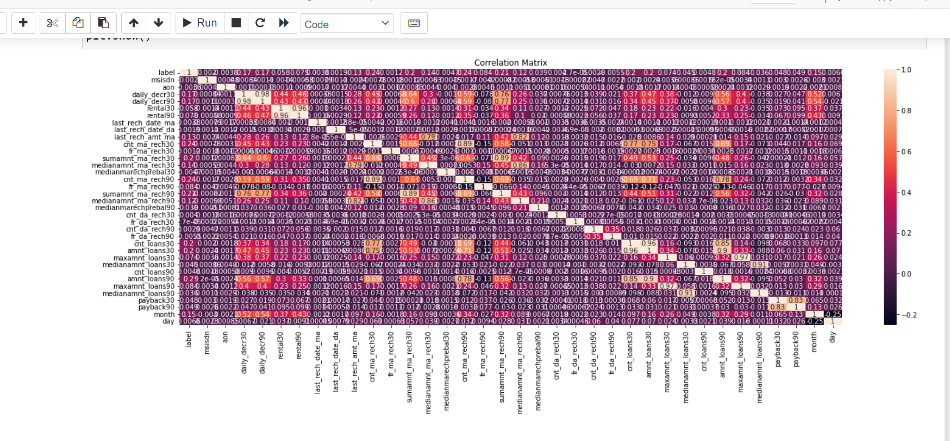
Visualization
To understand feature relationship with label we have used scatterplot and bar plot.
Used heatmap to check correlation between columns.

Slide 6
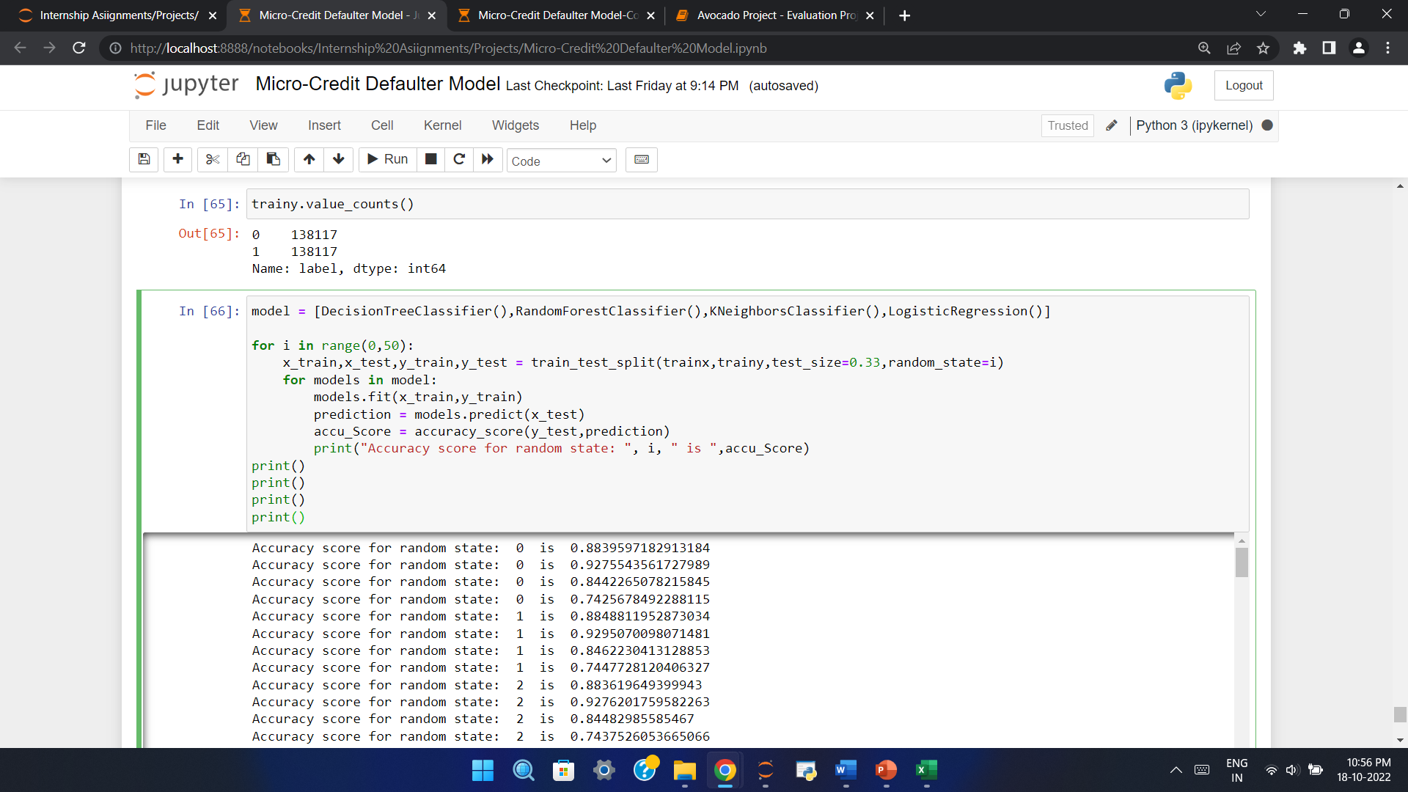
Model
As target column is categorical with two values (0 and 1) we can select Logistic regression or classifier models.
In this case we have used Decision Tree Classifier, Random Forest Classifier, KNeighbours Classifier and Logistic Regression.
As this is a classification problem so we use accuracy score, classification report and confusion matrix as our evaluation matrix.

Slide 7
Conclusion
Random Forest Model is the best model out of all model tested.
we can conclude that our model is predicting around 93% of correct results for Label
Mean accuracy is 93%
Standard Deviation is 0.06

